Slide 1
Teaching reading

Slide 2
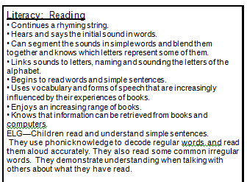
Where does reading fit into the Early years curriculum?
Don’t forget! Reading is an incredibly important part o the Early Years curriculum but it is a small part of it.

Slide 3
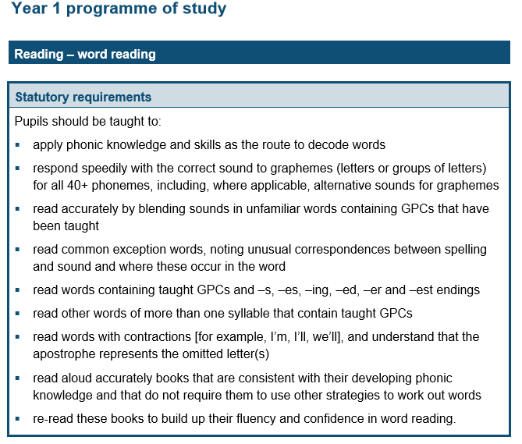
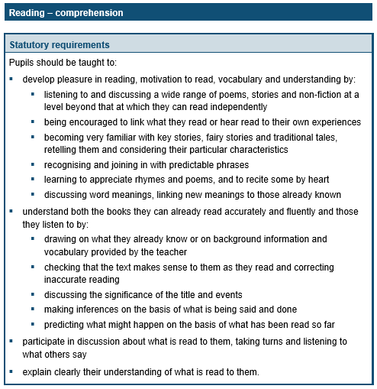
Where does reading fit into the National curriculum?

Slide 4
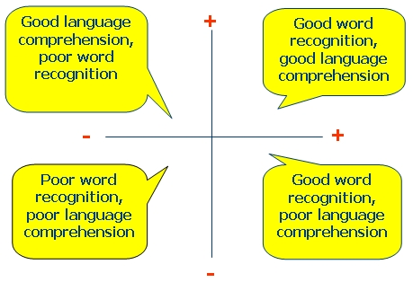
The simple view of reading

Slide 5
What we do...
Jolly phonics actions
Letters and sounds
Notes:
Introduce letters and sounds scheme by pointing to the sound wall.
We do this combined with the jolly phonics actions (refer to print out!)
Practise, practise, practise!

Slide 6
What happens in phonics sessions?
Teach a new sound every day.
Teach tricky words.
Teach the correct
formation of the letter
and children will write it
on individual whiteboards.
Children are encouraged
to sound out words and
write them.

Slide 7
Getting them reading!
Picture books
See-saw books
CVC word books
Books with longer words
to sound out.

Slide 8
Spending time reading with your child.
Reading is hard! It can be very frustrating but try to be as patient as you can – they will get there!
Don’t do it too late at night.
If the children are too tired then it will become a negative experience. Many people squeeze it in first thing or as they have come home from school.
‘Picture talk’
The pictures are really important in early books. Discuss them with your child. Try questions such as:
“What do you think they are doing?”
“What will happen next?”
Don’t worry!
Families are so busy. We understand if you can’t squeeze it in all of the time. As often as you can is great.

Slide 9
Book bands

Slide 10
Helping at home
You don’t have to just read books – it can be signs, cards... anything!
Please read with your child as often as you can!
Use reading websites.
Reading to your children.
Playing games – eye spy is great!

Slide 11
Useful bits and bobs!
www.twinkl.com
www.phonicsplay.com
www.oxfordowl.com
Pocket phonics (an app
for the ipads)

